Slide 1
Module 2.1
B-Tree, B+ Tree

Slide 2
B–Tree (Height balanced m-way search Tree)
A tree in which a node can store more than one values(keys) and it can have more than two children.
B-Tree is a self balanced search tree with multiple keys in every node and more than two children for every node.
Here no. of keys in a node and no. of children for a node depends on the order of B-Tree. Every B-tree has order.

Slide 3
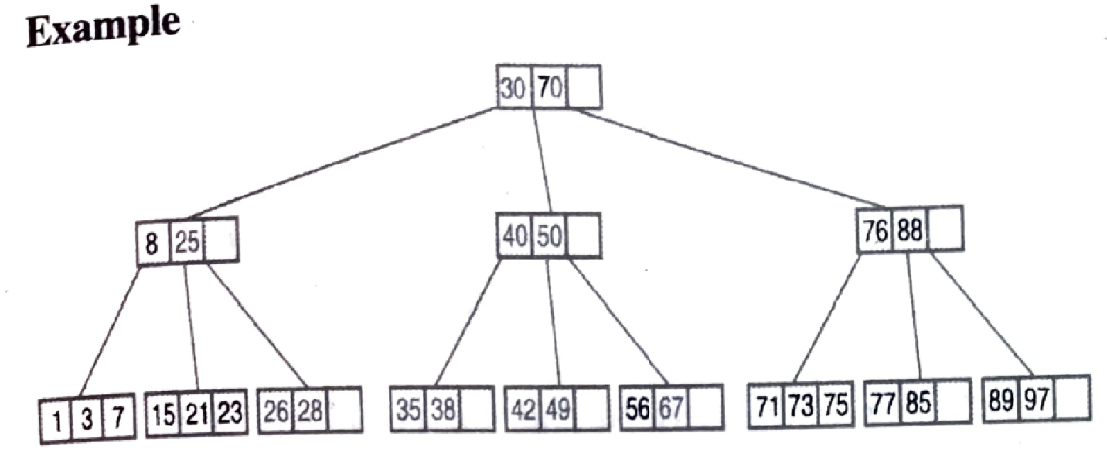
Properties of B – Tree(of order m)
All leaf nodes must be at the same level.
All nodes except root must have at least [m/2 -1] keys and maximum of m-1 keys.
All non-leaf nodes except root node must have at least m/2 children.
If root node is a non-leaf node then it must have at least 2 children.
A non-leaf node with n-1 keys must have n children.
All the key values within a node must be in ascending order.
Example: A B-Tree of order 4 contains max 3 key values in a node and max 4 children for a node.

Slide 4
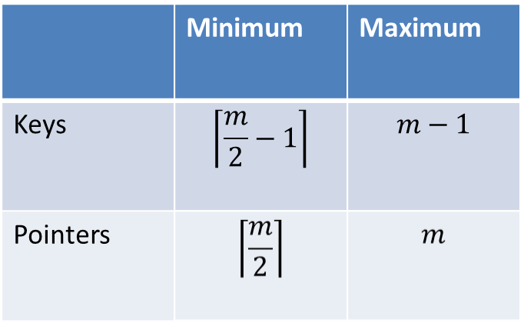
This table is applicable to all nodes in B-tree except Root node.

Slide 5
Operations on B – Tree
Search
Insertion
Deletion

Slide 6
Search Operations on B–Tree
Similar to BST.
In BST , serach starts from root node and each time we make a 2-way decision (either go to left or to right)
In B –Tree also search process starts from root but every time we make n-way decision where n is no. of children of that node.
Steps:

Slide 7
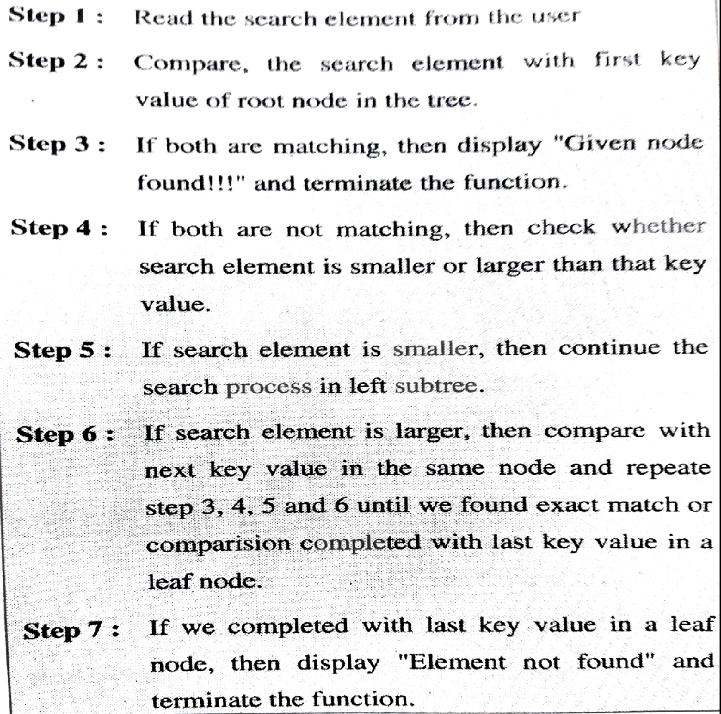

Slide 8
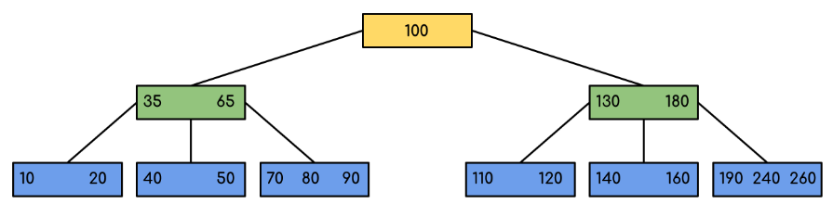
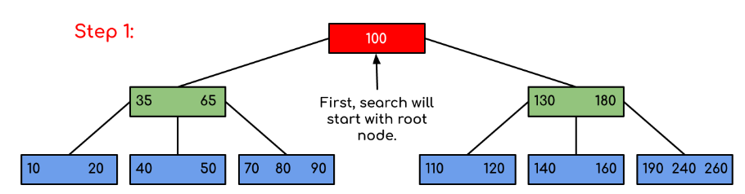
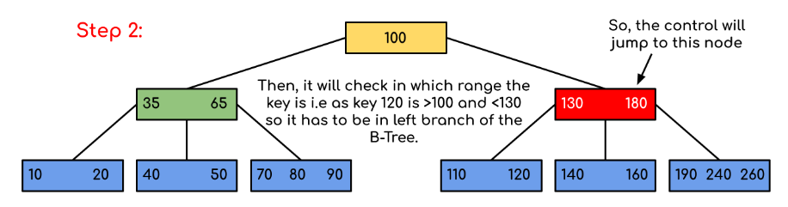
Searching
120 in the given B-Tree.

Slide 9
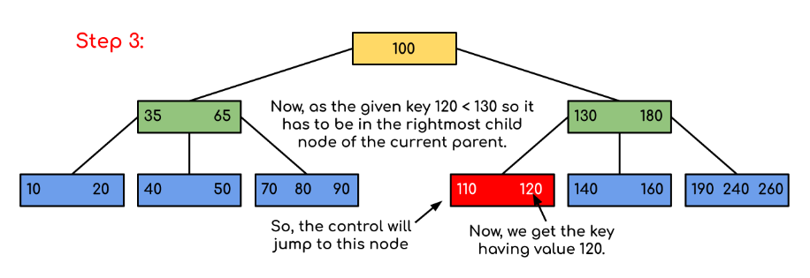

Slide 10
Procedure for inserting into a B-Tree
Attempt to insert the new key into a leaf
If this would result in that leaf becoming too big, split the leaf into two, promoting the middle key to the leaf’s parent
If this would result in the parent becoming too big, split the parent into two, promoting the middle key
This strategy might have to be repeated all the way to the top
If necessary, the root is split in two and the middle key is promoted to a new root, making the tree one level higher

Slide 11
Constructing a B-tree
Example 1: Suppose we start with an empty B-tree and keys arrive in the following order:
1 12 8 2 25 6 14 28 17 7 52 16 48 68 3 26 29 53 55 45
We want to construct a B-tree of order 5
The first four items go into the root:
To put the fifth item in the root would violate condition.
Therefore, when 25 arrives, pick the middle key to make a new root
1
2
8
12

Slide 12
Constructing a B-tree (contd.)
8
1
2
12
25
6, 14, 28 get added to the leaf nodes:
8
1
2
6
12
14
25
28

Slide 13
Constructing a B-tree (contd.)
Adding 17 to the right leaf node would over-fill it, so we take the middle key, promote it (to the root) and split the leaf
8
17
1
2
6
12
14
25
28
7, 52, 16, 48 get added to the leaf nodes
8
17
1
2
6
7
12
14
16
25
28
48
52

Slide 14
Constructing a B-tree (contd.)
Adding 68 causes us to split the right most leaf, promoting 48 to the root, and adding 3 causes us to split the left most leaf, promoting 3 to the root; 26, 29, 53, 55 then go into the leaves
3
8
17
48
1
2
6
7
12
14
16
25
26
28
29
52
53
55
68
Adding 45 causes a split of
25
26
28
29
and promoting 28 to the root then causes the root to split

Slide 15
Constructing a B-tree (contd.)
17
3
8
28
48
1
2
6
7
12
14
16
25
26
29
45
52
53
55
68

Slide 16
Example2: 10, 20, 30, 40, 50, 60, 70, 80 and 90 . Create a B-Tree of order 5.

Slide 17


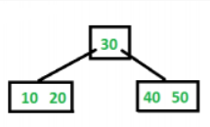

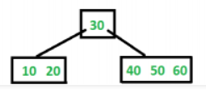
Example2: 10, 20, 30, 40, 50, 60, 70, 80 and 90 . Create a B-Tree of order 5.

Slide 18

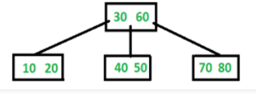


sequence of integers 10, 20, 30, 40, 50, 60, 70, 80 and 90

Slide 19
Removal from a B-tree
During insertion, the key always goes into a leaf. For deletion we wish to remove from a leaf. There are three possible ways we can do this:
If the key is already in a leaf node, and removing it doesn’t cause that leaf node to have too few keys, then simply remove the key to be deleted.
If the key is not in a leaf then it is guaranteed (by the nature of a B-tree) that its predecessor or successor will be in a leaf -- in this case we can delete the key and promote the predecessor or successor key to the non-leaf deleted key’s position.

Slide 20
Removal from a B-tree
If (1) or (2) lead to a leaf node containing less than the minimum number of keys then we have to look at the siblings immediately adjacent to the leaf in question:
if one of them has more than the min. number of keys then we can promote one of its keys to the parent and take the parent key into our lacking leaf
if neither of them has more than the min. number of keys then the lacking leaf and one of its neighbours can be combined with their shared parent (the opposite of promoting a key) and the new leaf will have the correct number of keys; if this step leave the parent with too few keys then we repeat the process up to the root itself, if required.

Slide 21
Type #1: Simple leaf deletion If the key is already in a leaf node and removing it doesn’t cause that leaf node to have too few keys, then simply remove the key to be deleted.
Assuming a B-Tree of order 5 , as before...
12
29
52
2
7
9
15
22
31
43
56
69
72
Delete 2: Since there are enough
keys in the node, just delete it

Slide 22
Type #2: Simple non-leaf deletion
If the key is not in a leaf then it is guaranteed (by the nature of a B-tree) that its predecessor or successor will be in a leaf -- in this case we can delete the key and promote the predecessor or successor key to the non-leaf deleted key’s position.
Type #2: Simple non-leaf deletion
Assuming a B-Tree of order 5 , as before...
12
29
52
Delete 52
2
7
9
15
22
31
43
56
69
72
12
29
56
2
7
9
15
22
31
43
69
72

Slide 23
Type #3: Enough siblings If (1) or (2) lead to a leaf node containing less than the minimum number of keys then we have to look at the siblings immediately adjacent to the leaf in question: -----If one of them has more than the min. number of keys then we can promote one of its keys to the parent and take the parent key into our lacking leaf
12
29
7
9
15
22
31
43
56
69
Delete 22
12
29
Demote root key and
promote leaf key
7
9
15
22
31
43
56
69

Slide 24
Type #3: Enough siblings(cntd...)
If (1) or (2) lead to a leaf node containing less than the minimum number of keys then we have to look at the siblings immediately adjacent to the leaf in question: -----If one of them has more than the min. number of keys then we can promote one of its keys to the parent and take the parent key into our lacking leaf
12
31
7
9
15
29
43
56
69

Slide 25
Type #4: Too few keys in node and its siblings If (1) or (2) lead to a leaf node containing less than the minimum number of keys then we have to look at the siblings immediately adjacent to the leaf in question: --if neither of them has more than the min. number of keys then the lacking leaf and one of its neighbors can be combined with their shared parent (the opposite of promoting a key) and the new leaf will have the correct number of keys; if this step leave the parent with too few keys then we repeat the process up to the root itself, if required.
12
29
56
Delete 72
7
9
15
22
31
43
69
72
Lacking leaf +Sibling + their Shared parent

Slide 26
Type #4: Too few keys in node and its siblings If (1) or (2) lead to a leaf node containing less than the minimum number of keys then we have to look at the siblings immediately adjacent to the leaf in question: --if neither of them has more than the min. number of keys then the lacking leaf and one of its neighbors can be combined with their shared parent (the opposite of promoting a key) and the new leaf will have the correct number of keys; if this step leave the parent with too few keys then we repeat the process up to the root itself, if required.
12
29
56
Join back together
7
9
15
22
31
43
69
72
Too few keys!
Delete 72
Note when printed: this slide is animated

Slide 27
Type #4: Too few keys in node and its siblings
12
29
7
9
15
22
31
43
56
69

Slide 28
Exercise in Removal from a B-Tree
Given B-tree of order 5 created by following data
3, 7, 9, 23, 45, 1, 5, 14, 25, 24, 13, 11, 8, 19, 4, 31, 35, 56
Add these further keys: 2, 6,12
Delete these keys: 4, 5, 7, 3, 14

Slide 29
Create a B-Tree of order 5 using following data
3, 7, 9, 23, 45, 1, 5, 14, 25, 24, 13, 11, 8, 19, 4, 31, 35, 56
Add these further keys: 2, 6,12 , Delete these keys: 4, 5, 7, 3, 14

Slide 30
Create a B-Tree of order 5 using following data
3, 7, 9, 23, 45, 1, 5, 14, 25, 24, 13, 11, 8, 19, 4, 31, 35, 56
Add these further keys: 2, 6,12 , Delete these keys: 4, 5, 7, 3, 14

Slide 31
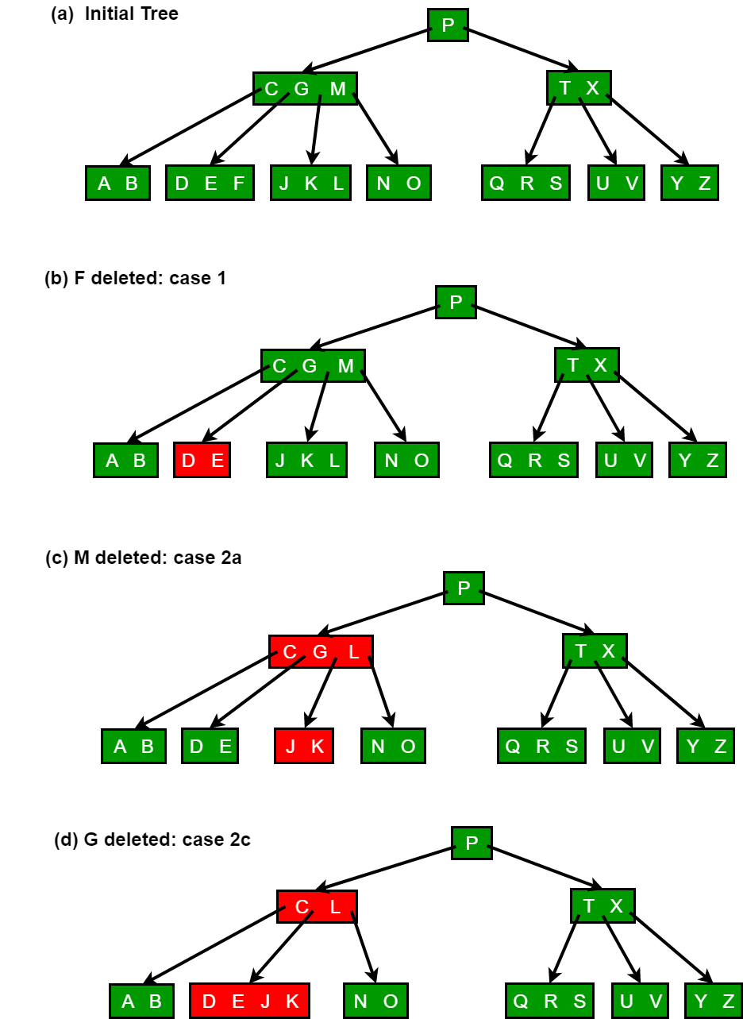
m=5
Min =2
Max =4

Slide 32
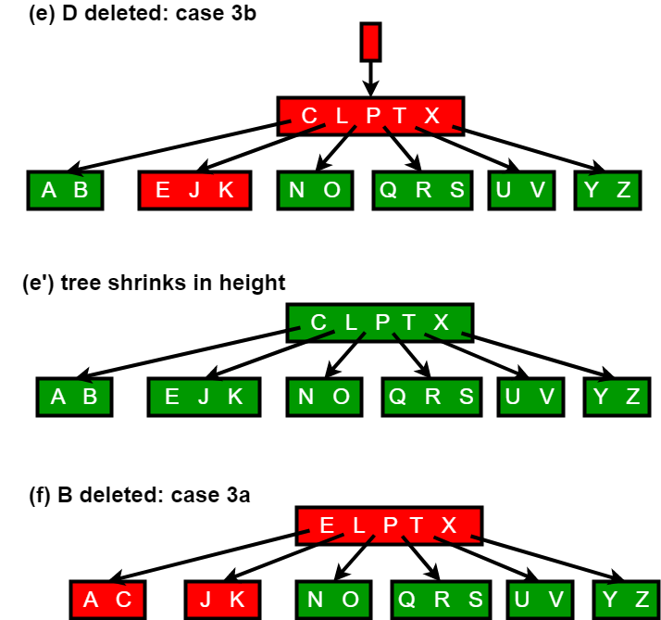
m=6
Min =2
Max =5

Slide 33
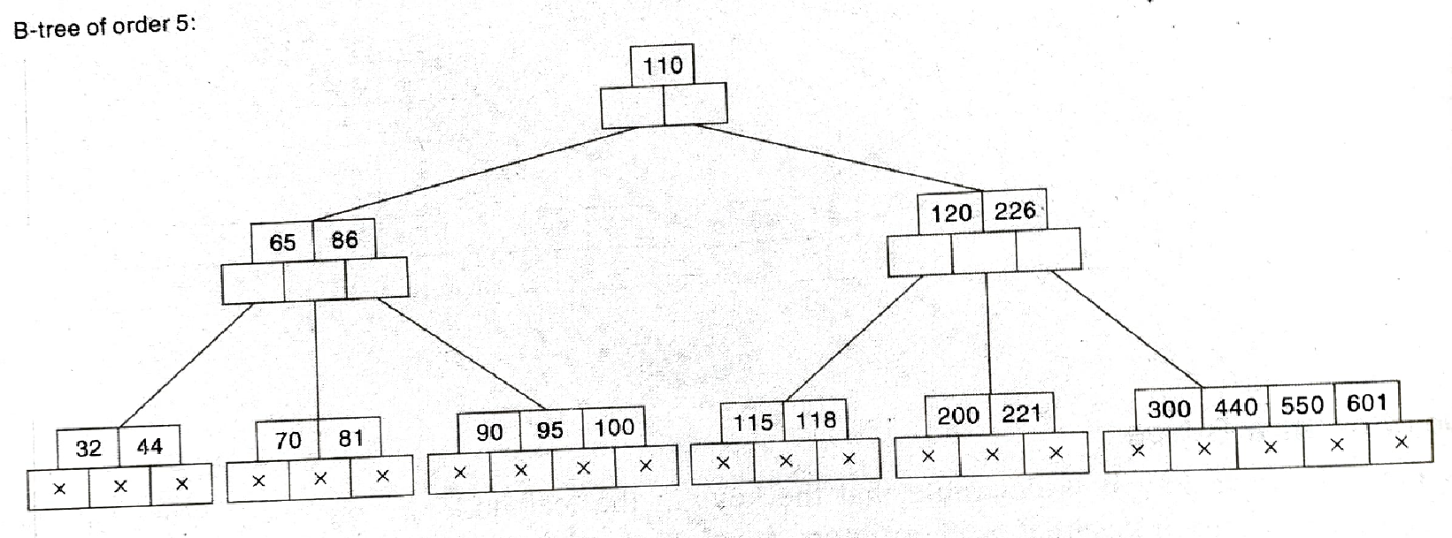
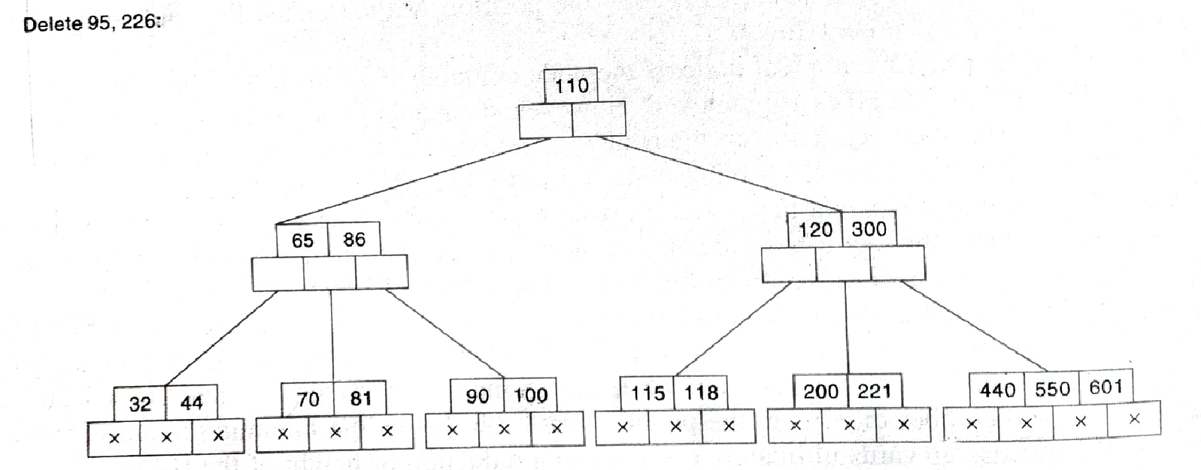

Slide 34
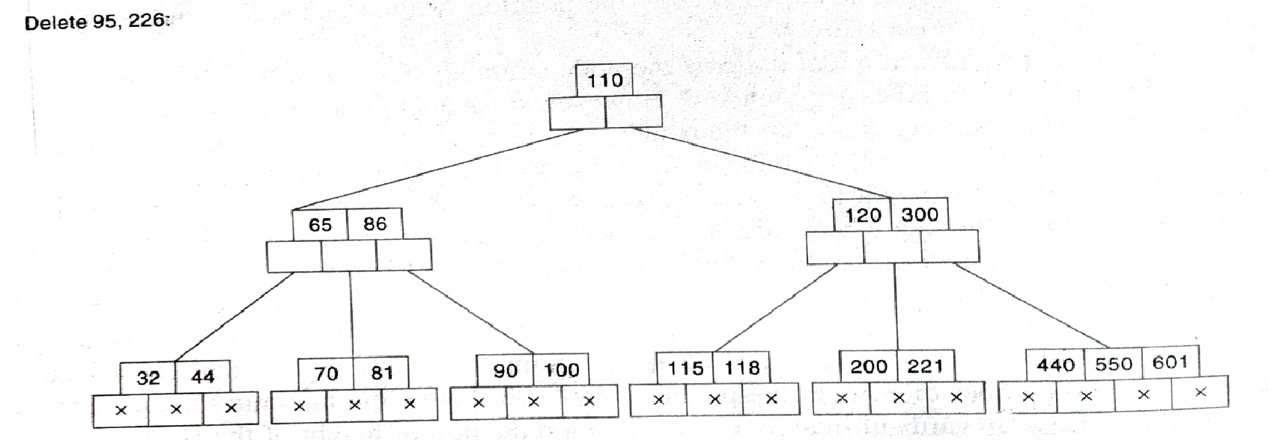
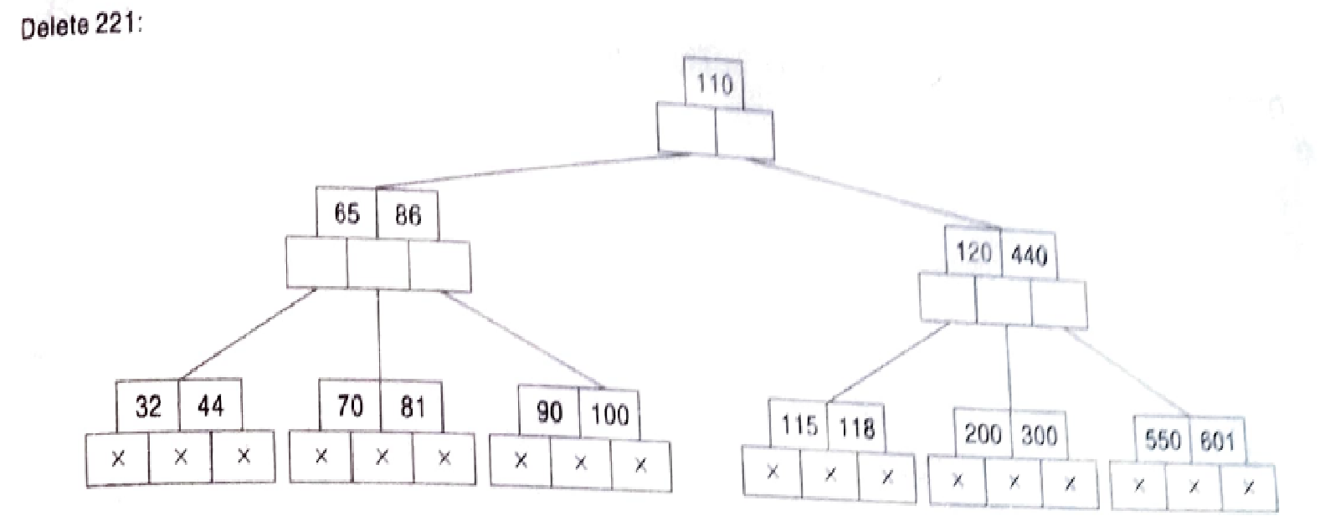

Slide 35

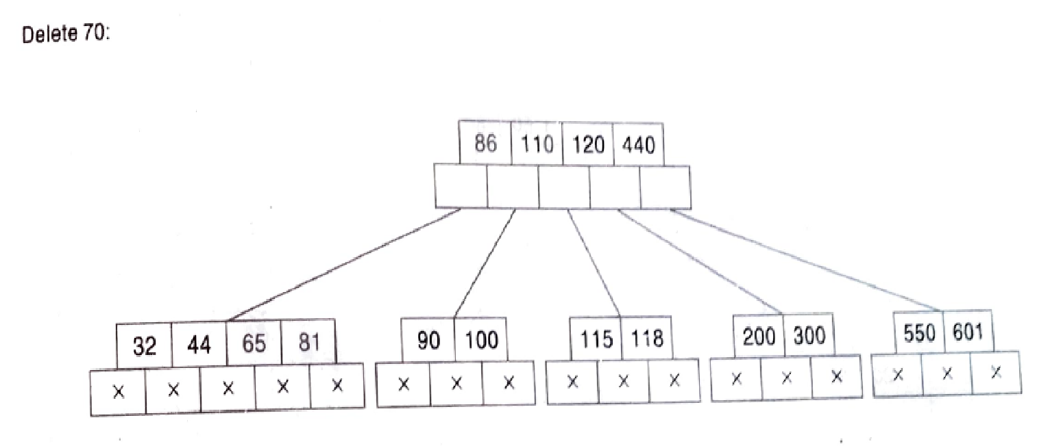

Slide 36
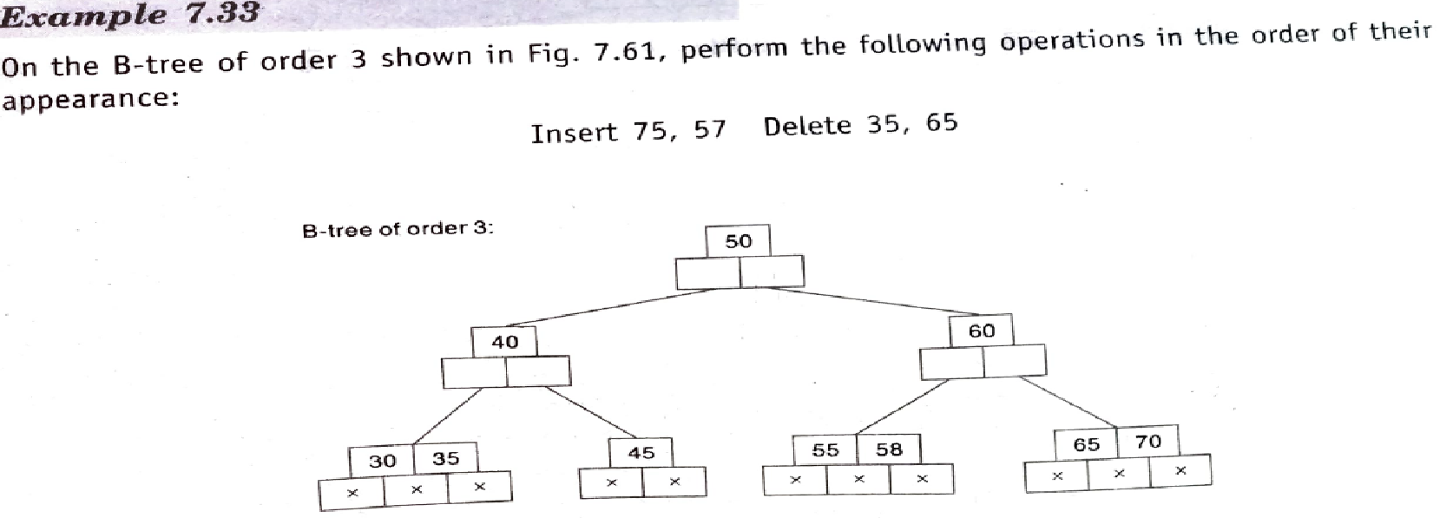
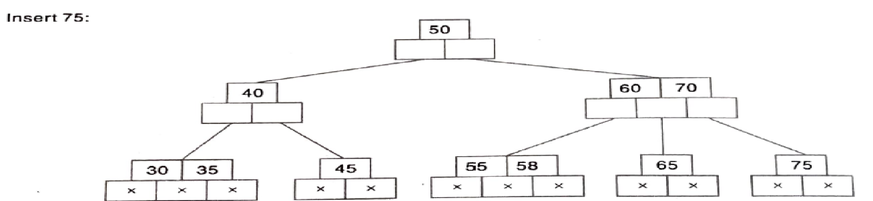
m=3
Min=1
Max=2

Slide 37
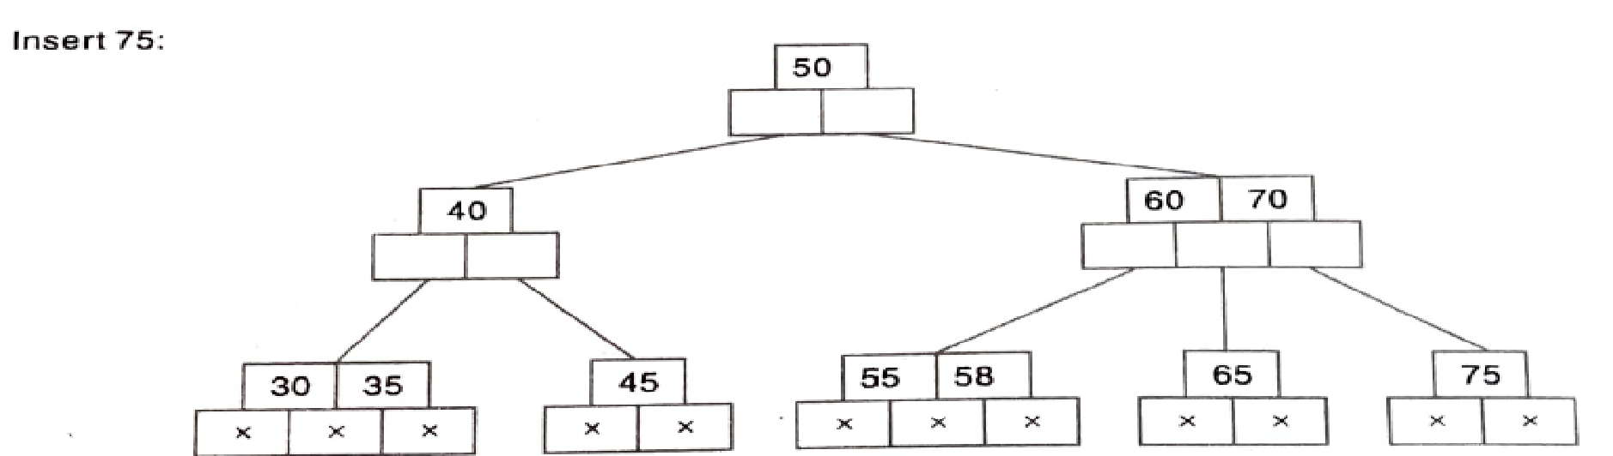
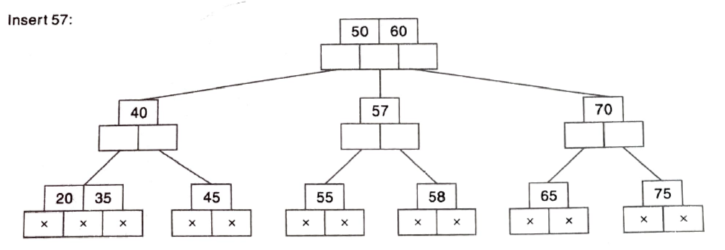

Slide 38

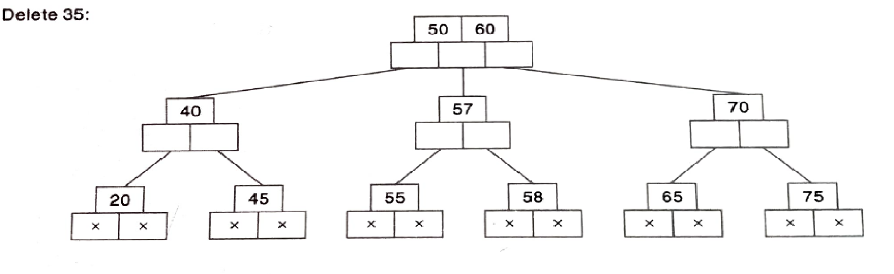

Slide 39
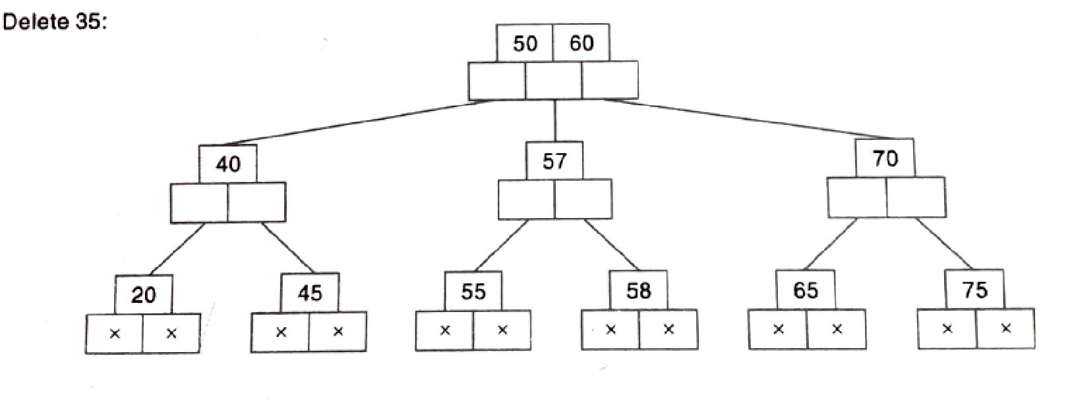
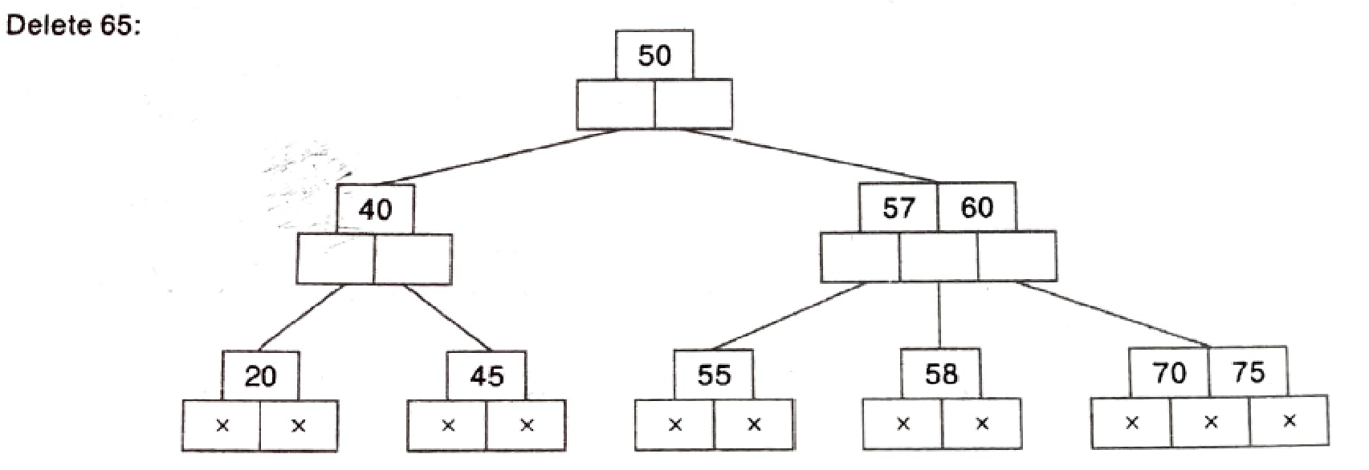
All leaf nodes should be at same level)

Slide 40
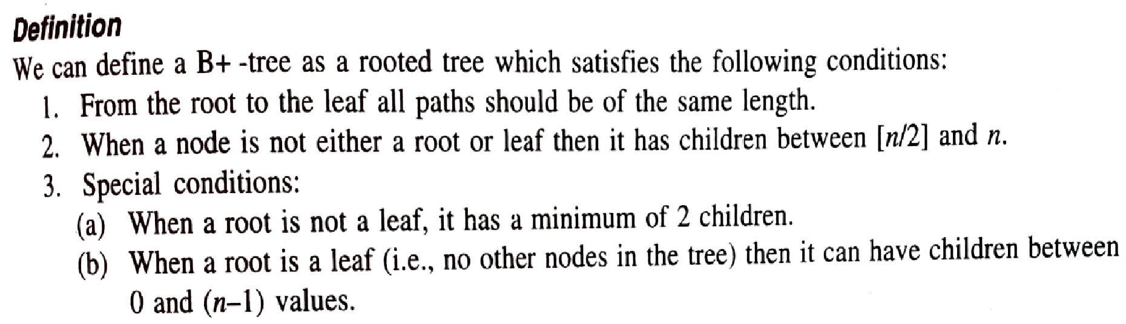
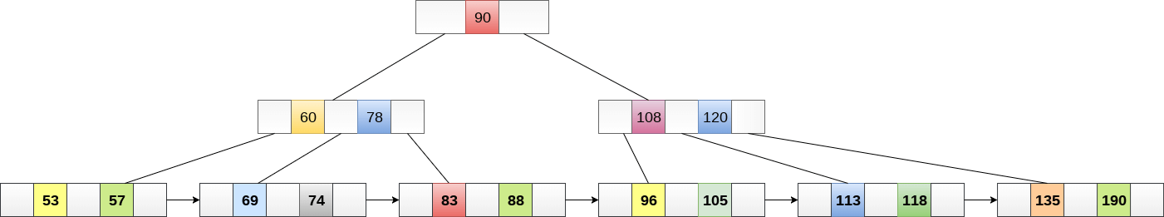
B+ Tree(of order n)
B+ Tree is an extension of B Tree which allows efficient insertion, deletion and search operations.

Slide 41
B+ Tree
B+ Tree is an extension of B Tree which allows efficient insertion, deletion and search operations.
The leaf nodes of a B+ tree are linked together in the form of a singly linked lists to make the search queries more efficient.
B+ Trees are used to store the large amount of data which can not be stored in the main memory.
As size of main memory is always limited, the internal nodes (keys to access records) of the B+ tree are stored in the main memory whereas, leaf nodes are stored in the secondary memory.
The internal nodes of B+ tree are often called index nodes.

Slide 42
Comparison of B Tree and B+ Tree
The data pointers are present only at the leaf nodes on a B+ tree whereas the data pointers are present in the internal, leaf or root nodes on a B-tree.
The leaves are not connected with each other on a B-tree whereas they are connected on a B+ tree.
Operations on a B+ tree are faster than on a B-tree.

Slide 43
B Tree Vs B+ Tree
SN | B Tree | B+ Tree
1 | Search keys can not be repeatedly stored. | Redundant search keys can be present.
2 | Data can be stored in leaf nodes as well as internal nodes | Data can only be stored on the leaf nodes.
3 | Searching for some data is a slower process since data can be found on internal nodes as well as on the leaf nodes. | Searching is comparatively faster as data can only be found on the leaf nodes.
4 | Deletion of internal nodes are complicated and time consuming. | Deletion will never be a complexed process since element will always be deleted from the leaf nodes.
5 | Leaf nodes can not be linked together. | Leaf nodes are linked together to make the search operations more efficient.
6. | Insert, delete , search : Avg case TC= O(log n) | Insert, delete , search : Avg case TC= O(log n)
https://stepik.org/lesson/31445/step/6

Slide 44
B+ Tree
B+ Tree is an extension of B Tree which allows efficient insertion, deletion and search operations.
In B Tree, Keys and records both can be stored in the internal as well as leaf nodes. Whereas, in B+ tree, records (data) can only be stored on the leaf nodes while internal nodes can only store the key values.
The leaf nodes of a B+ tree are linked together in the form of a singly linked lists to make the search queries more efficient.
B+ Trees are used to store the large amount of data which can not be stored in the main memory.
Due to the fact that, size of main memory is always limited, the internal nodes (keys to access records) of the B+ tree are stored in the main memory whereas, leaf nodes are stored in the secondary memory.
The internal nodes of B+ tree are often called index nodes.

Slide 45
B+ Tree
A B+ tree of order 3 is shown in the following figure.
Advantages of B+ Tree
Height of the tree remains balanced and less as compared to B tree.
We can access the data stored in a B+ tree sequentially as well as directly.
Keys are used for indexing.
Faster search queries as the data is stored only on the leaf nodes.

Slide 46
B+ Tree
A B+ tree of order 3 is shown in the following figure.

Slide 47
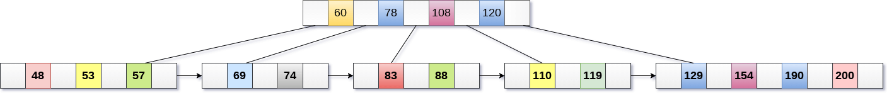
Insertion in B+ Tree
Insertion in B+ Tree
Step 1: Insert the new node as a leaf node
Step 2: If the leaf doesn't have required space, split the node and copy the middle node to the next index node.
Step 3: If the index node doesn't have required space, split the node and copy the middle element to the next index page.
Example :
Insert the value 195 into the B+ tree of order 5 shown in the following figure.

Slide 48
Insertion in B+ Tree
Example :
Insert the value 195 into the B+ tree of order 5 shown in the following figure.
195 will be inserted in the right sub-tree of 120 after 190. Insert it at the desired position.
The node contains greater than the maximum number of elements i.e. 4, therefore split it and place the median node up to the parent.

Slide 49
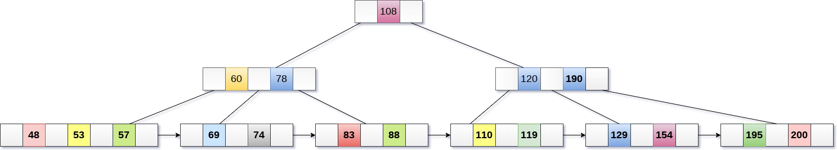
Insertion in B+ Tree
Now, the index node contains 6 children and 5 keys which violates the B+ tree properties, therefore we need to split it, shown as follows.

Slide 50

Deletion in B+ Tree
Deletion in B+ Tree
Step 1: Delete the key and data from the leaves.
Step 2: if the leaf node contains less than minimum number of elements, merge down the node with its sibling and delete the key in between them.
Step 3: if the index node contains less than minimum number of elements, merge the node with the sibling and move down the key in between them.
Example :
Delete the key 200 from the B+ Tree of order 5 shown in the following figure.

Slide 51
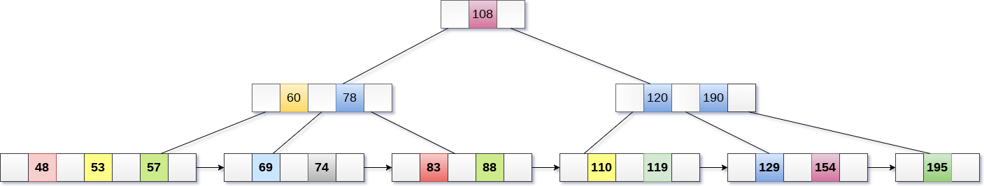
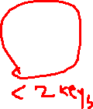
Insertion in B+ Tree
Example :
Delete the key 200 from the B+ Tree shown in the following figure.
200 is present in the right sub-tree of 190, after 195. delete it.

Slide 52
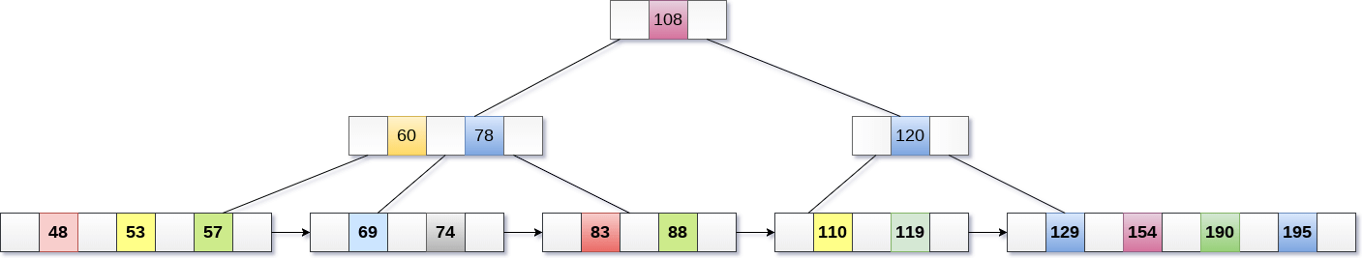

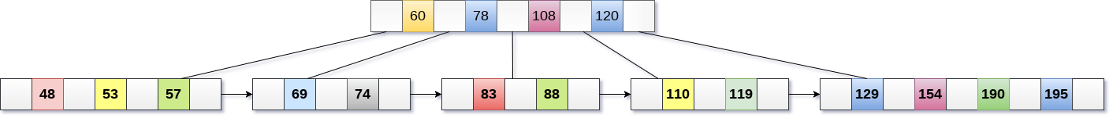
Merge the two nodes by using 195, 190, 154 and 129.
Now, element 120 is the single element present in the node which is violating the B+ Tree properties. Therefore, we need to merge it by using 60, 78, 108 and 120.
Now, the height of B+ tree will be decreased by 1.

